Slide 2
Graham County Broadband
As of 11/27/23
Mighty River, LLC
Joe Freddoso (919)247-5121

Slide 3
Collaborative Broadband Project
Help gather information necessary to apply for broadband infrastructure grants; digital equity grants
Research on a county level
Review and edit grant applications
Provide templates
Represent the counties in interfacing with Service Providers
Digital equity and adoption
Accountability framework
Standards of service
Reach of service
Affordability of service
County contribution
County network
Grant Funded – no cost to Counties

Slide 4
Broadband deployment is not complex
Least costly and least complicated infrastructure to deploy…
Easiest to maintain
Reason it hasn’t been deployed to everyone is:
For profit/unregulated deployment model
Not treated like a utility
Goal of the Collaborative Broadband Project is:
To remove the complexity from broadband
Advise local governments to make good decisions on broadband investments
Make broadband service providers accountable to deliver on promises

Slide 5
Broadband Service goals Graham County
What funding has already been awarded?
What locations will be served?
Key traits of service providers?
Local presence
Special rates for qualifying low-income residents
Frequent reports to County on construction progress
Frequent reports to County on service quality
Every home served with an affordable, scalable broadband connection. What type of service is preferred?

Slide 6
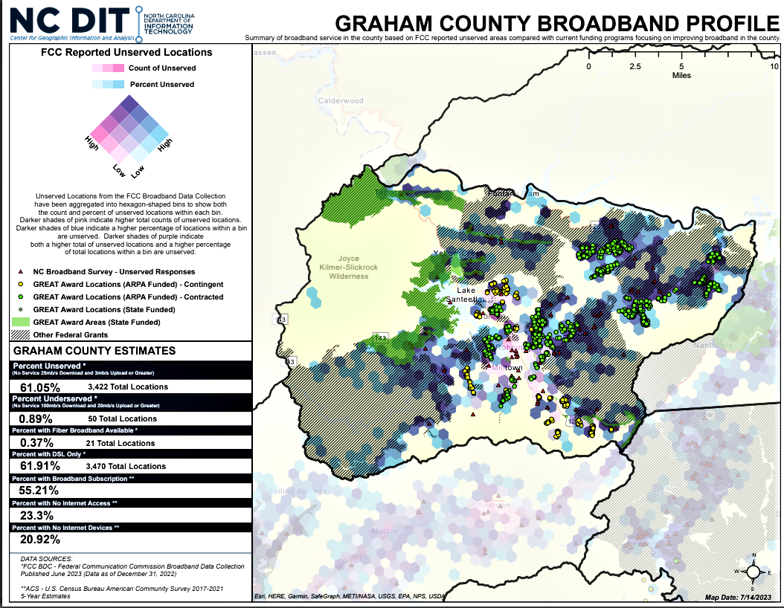
SOURCE MAP

Slide 7
Any broadband infrastructure funding before 2020
Delivers only a 25Mbps download and 3Mbps upload

Slide 8
Federal and State of NC – Broadband Funding Fiber to the Home – 100Mbps Symmetrical
BEAD
- State of NC with NTIA Funds (IIJA)
- 2025 Award
-2026-2028 Construction
- Service Provider and County match may be required (25% of project cost)
CAB
- State of NC with US Treasury Funds (ARPA)
- 2024 Award
- 2024-2026 Construction
- County Match Required
GREAT
- State of NC with US Treasury Funds (ARPA)
- 2023 Award
- 2023-2025 Construction
RDOF
- FCC
- 2018-2019 Award
- 2022-2026 implementation

Slide 9
Existing Awards-RDOF
Company | Last-Mile Technology | Locations | 10-year support
CCO Holdings, LLC (Charter/Spectrum) | Fiber | 2,310 | $3,362,015.00
Space Explorations Technologies Corp (Denied) | Fiber | 23 | $18,277.80
Confirmed June 2022
40% complete by June 2025
60% complete by June 2026
80% complete by June 2027
100% complete by June 2028
Link to RDOF Website

Slide 10
RDOF Questions
Strategy-invite these three providers to present to the commissioners?
For all companies:
How are you progressing according to your deployment timeline?
Can you share the FCC progress reports for Graham County?
Do you have any other plans for service deployment in Graham County?
Will you offer a low-income plan?
Will you offer subsidy for devices?

Slide 11
Existing Awards-GREAT Grant
Provider | Last Mile Technology | Residential Locations | Grant Amount | Service Provider Match
Zitel LLC | Fiber | 897 | $2,663,954.55 | $470,109.63
Zito West Holding, LLC | Fiber | 217 | $619,916.65 | $109,397.06
*Contingent awards are subject to change, contracts are not yet signed
Construction period cannot last more than 2 years after contract
100Mbps download and 100Mbps upload speeds to every location
Service must be available to all locations two years after the contract agreement is signed.
Agreement with State requires a construction timeline
Agreement with the State expires in 5 years
Link to GREAT Grant Award Site

Slide 12
Questions for Zitel LLC - after GREAT Grant Agreement
Can you share the construction timeline you provided to the State?
What locations will be served when?
Can the County assist you in anyway?
Land for equipment storage?
One point of contact for permitting, etc.?

Slide 13
CAB Project Funding
Role of Counties
Decide on matching funds – match from County is required
County match is based on the amount of ARPA funds received by the County
Fair process to select the service provider partner
NC Division of Broadband and Digital Equity
Template RFP
Template Agreement between County and Service Provider(s)
NC Rural Center Collaborative Broadband Project
Advice in selection process
Advice in contracting with Service Provider

Slide 16
Graham County
ARPA LFRF
County Match is 5% of the Grant request so for a $4M grant its $200,000.
US Treasury State and Local Fiscal Recovery Site
North Carolina | Graham County | $1,639,565.00

Slide 17
Graham County
NCDIT Division of Broadband and Digital Equity - BEAD Grants
BEAD Five-Year Plan
Read the BEAD Five-Year Plan, which includes feedback received during the public comment period. It outlines how NCDIT will invest BEAD funding across North Carolina. This plan was approved by the National Telecommunications and Information Administration (NTIA) and National Institute of Standards and Technology (NIST).
BEAD Initial Proposal
The draft initial proposal is divided into two volumes and is available for public comment via email to NCDITpartnerfeedback@nc.gov until Tuesday, Dec. 5 at 5 p.m.
The draft BEAD initial proposal provides responses to the BEAD Notice of Funding Opportunity requirements and comes after NTIA’s approval of the division’s five-year action plan in August. The proposal addresses the division’s plans for the competitive process it will use to select subgrantees for broadband and digital equity projects, ensure workforce development, continue stakeholder engagement, and engage historically underutilized businesses and underrepresented groups in BEAD deployment.
Volume 1 Draft
Volume 2 Draft
Workforce Development Draft Plan
This draft initial proposal will go through a number of revisions in the coming months. Prior to submitting the initial proposal to the NTIA in December, NCDIT will, in its discretion, revise the draft pursuant to feedback received during the public comment period.
NC received $1.5 billion in a BEAD allocation from the Infrastructure Investment and Jobs Act. This funding will be managed by the NTIA. NC DIT received 20% of these funds when NTIA approved the Five-Year Plan. NC DIT must have its Initial Proposals approved by the NTIA to release the remaining 80% of BEAD Funds.

Slide 18
Suggestions for moving forward
County broadband action task force?
Advertise for an experienced volunteer
School district participation
Other participants
Face to face session with Dr. Riddick (NC Rural Center consultant - Gates County connection)
Provider accountability
Presentations to Commissioners from
1) RDOF
2) GREAT
3) County funded providers
4) Providers deploying without government funding

Slide 19
Questions?

